Slide 1



Deep Learning–Based Style Analysis of Ancient Hebrew Sources
Case study: The Torah authorship
26-1-R-19
By: Alexander Grumman & Shlomo Zrihan.
Advisor:Dr. Renata Avros Prof. Zeev Volkovich
Academic Presentation
15 Slides

Slide 2














Current Situation & Need
The analysis of biblical authorship presents unique challenges that require modern computational approaches.
Traditional Approach
Data-Driven Need
Manual & Interpretive
Measurable Workflow
Relies on expert knowledge and subjective judgment
Objective analysis with quantifiable results
Slow Process
Efficient Analysis
Time-consuming analysis of extensive texts
Automated processing of large textual corpora
Hard to Reproduce
Reproducible Results
Results may vary between different analysts
Consistent outcomes through standardized methods
Key Focus: Our goal is not to make theological judgments, but to build a scientific tool that generates measurable data and visualizations.

Slide 3











Problem Definition
Problem
Detect subtle stylistic differences inside a single extensive text
Research Question
Is the Torah stylistically consistent, or does it show evidence of multiple distinct styles?
Constraints
Biblical Hebrew Ancient language with archaic features
Domain Mismatch For modern language models
Key Challenge: Biblical Hebrew presents greater difficulties than modern texts due to its ancient nature, archaic spelling, and tokenization challenges.

Slide 4
























Proposed Solution (High-Level)
Our approach combines two powerful methods to analyze stylistic consistency in ancient Hebrew texts.
Deep Impostors
Sen2Pro
Style Signals
Identifies stylistic differences by comparing text segments to multiple styles
Generates probabilistic embeddings that capture uncertainty in representation
Continuous numeric signals representing stylistic features along the text
Integration
Analysis
Flexibility
Sen2Pro enhances Deep Impostors by adding uncertainty-aware embeddings
Compare signals using distance metrics and detect outliers via clustering
Adaptable framework for various textual analysis tasks beyond authorship
We turn text into a signal, then analyze signals like time-series.

Slide 5













Background: Author Verification & Impostors
Author verification methods form the foundation for authorship analysis.
Source Text
Target Text
Verification Result
Match
No Match
Author Verification
Extrinsic Verification
Impostors Idea
"Does this text match a source style?"
Uses external texts as negative class
Compare target to many different styles
Traditional approach
Compares against known authors
Broad style comparison
Key Insight: The impostors approach extends beyond simple matching to create a more robust verification system.

Slide 6

























Deep Impostors: Pipeline Core
The Deep Impostors pipeline transforms documents into style signals through a systematic process.
1. Document Segmentation
2. Pairwise Separator
3. Signal Aggregation
Break document into fixed-length batches
Train on two impostor collections
Score & aggregate batches into style signal
Batch 1
Style Signal
Batch 2
Batch 3
Pipeline Process Flow
Input Document
Segmentation
Batch Processing
Style Signal
Key Insight: Style is measured "locally" then aggregated into a continuous signal.

Slide 7
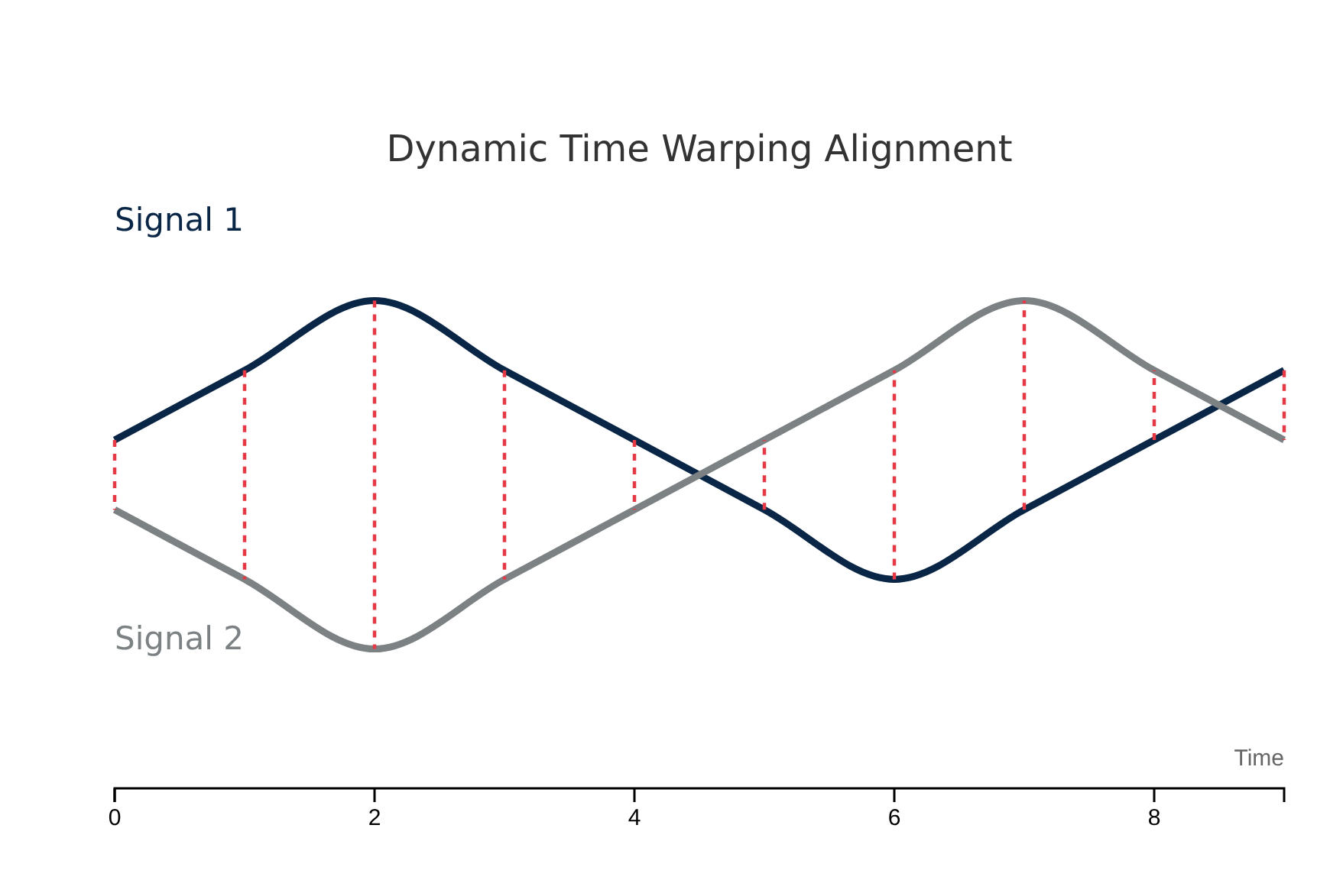





Deep Impostors: Comparing Signals (DTW)
Dynamic Time Warping
Problem: Signals can be similar but misaligned (shifted / stretched)
DTW Benefits:
Aligns patterns flexibly without strict alignment
Computes robust distance between signals
Handles temporal variations in signals
Example
"Same trend appears earlier in one book and later in another"
DTW creates an alignment path that minimizes the cumulative distance between points, allowing for flexible matching even when patterns are shifted or stretched.

Slide 8
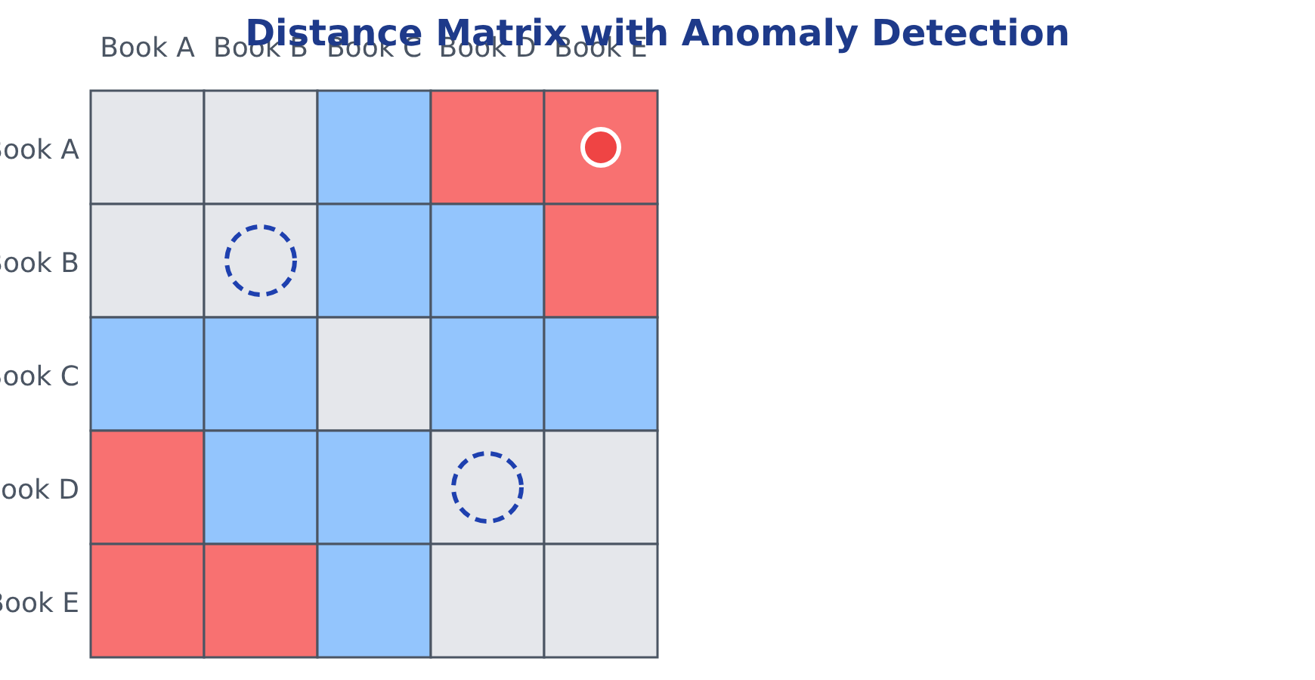











Deep Impostors: Outliers & Clusters
After generating style signals, we need to identify outliers and group similar texts:
1. Distance Matrix
Build a pairwise distance matrix between texts/signals
2. Anomaly Scoring
Apply Isolation Forest for anomaly detection
3. Clustering
Use K-medoids to separate core vs suspicious groups
Core texts
Anomalies
Key Insight: This approach provides both a "distance map" and identifies anomalous segments.
Cluster centers
Similar texts

Slide 9




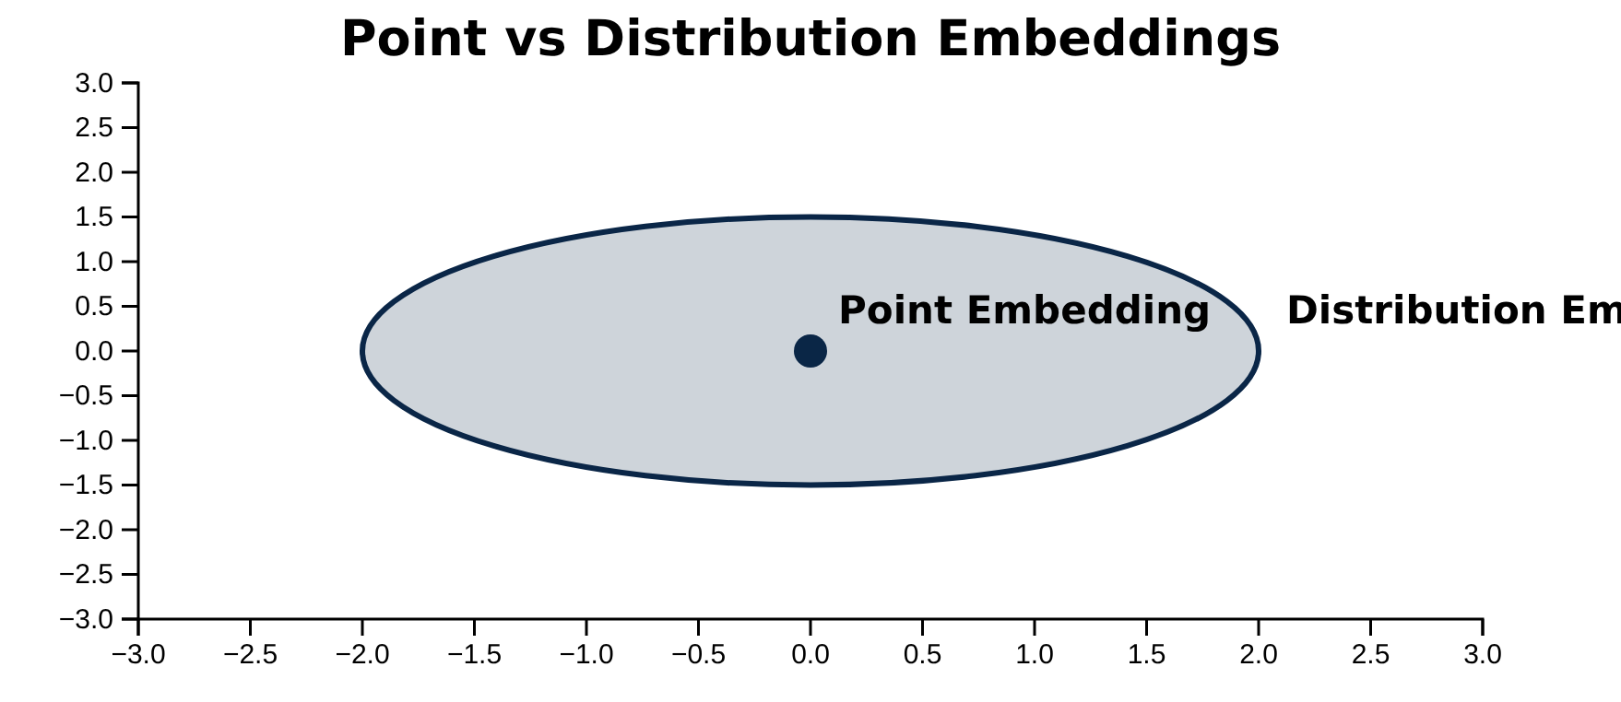






Sen2Pro: Why Probabilistic Embeddings?
Standard Embeddings
Represent a sentence as a single point
Fixed position in vector space
No uncertainty quantification
Sen2Pro Distribution Embeddings
Represents a sentence as a distribution
Why This Matters for Biblical Hebrew
Captures uncertainty in representation
Provides mean and covariance matrix
Uncertainty Awareness: Captures ambiguity in ancient texts
Robustness: Better handling of linguistic variation
Confidence Measures: Provides reliability scores
Key Insight: "Confidence-aware embeddings" frame semantic representation as a distribution rather than a point.

Slide 10








Sen2Pro: Sources of Uncertainty
Sen2Pro captures uncertainty in sentence representations through multiple sources.
Model Uncertainty
Data Uncertainty
Uses Monte-Carlo dropout
Uses word-level augmentation
Same sentence, multiple stochastic passes
Slightly varied sentences
Uncertainty Estimation
Estimate mean from samples
Estimate covariance from samples
Key Insight: Capturing uncertainty improves robustness in Biblical Hebrew analysis.

Slide 11

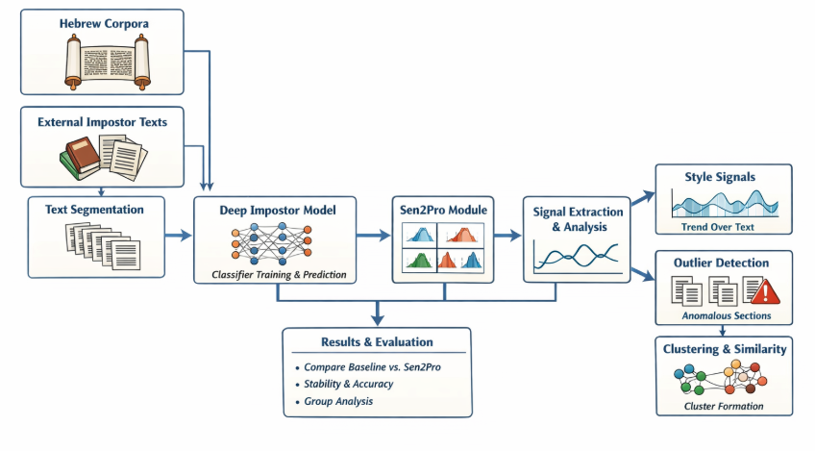








Integration: Sen2Pro inside Deep Impostors
Replacing deterministic embeddings with probabilistic representations to enhance robustness.
Deep Impostors Framework
Text Segmentation
Deterministic Embeddings
Style Signal Generation
Sen2Pro Enhancement
Probabilistic Embeddings
Mean + Covariance representation
Uncertainty Modeling
Robust Style Analysis

Slide 12









Engineering Decisions & Constraints
Key non-functional requirements guiding our technical approach:
Signal Stability & Reproducibility
Ensure consistent style signals across multiple runs. This requires deterministic processing and careful handling of random elements in the pipeline.
Implement fixed random seeds
Biblical Hebrew Linguistic Sensitivity
The model must account for the specific characteristics of Biblical Hebrew, including archaic spelling, lack of vowels/cantillation, and complex morphology.
Domain-specific tokenization
Resource Efficiency & Caching
Sampling is expensive; implement caching strategies to store intermediate results and avoid redundant computations.
Implement efficient caching with LRU eviction
Engineering Focus: These constraints ensure our system is not only theoretically sound but also practically viable for analyzing the Torah text.

Slide 13











Plan of Execution (Phases)
Our implementation follows a structured four-phase approach to ensure systematic development and validation.
1
2
3
4
Model Selection & Validation
Impostor Data Collection
Pipeline Implementation
Experimentation & Optimization
Gather diverse text samples
Implement core pipeline
Batch size tuning
Tokenization validation
Add Sen2Pro module
Sampling count optimization
Stability checks
Create impostor collections
Integration testing
Baseline performance metrics
Ensure linguistic diversity
Robustness validation
Implementation Focus: Each phase includes validation to ensure reproducibility and scientific rigor throughout the development process.

Slide 14


















Testing & Evaluation
Comparative analysis of model versions across multiple granularity levels using specific metrics.
Baseline Model
Enhanced Model
Components: Deep Impostors + deterministic embeddings
Components: Deep Impostors + Sen2Pro
Multi-granularity Analysis
Book level
Chapter level
Segment level
Success Metrics
Stability
Cluster Consistency
Uncertainty Correlation
Consistency of style signals across analyses
Homogeneity of clustered text segments
Relationship between model uncertainty and accuracy
Evaluation Approach: We assess model performance across multiple levels and metrics to validate effectiveness without requiring absolute "ground truth" labels.

Slide 15
























Contribution, Expected Challenges, Next Steps
Novelty / Contribution
Expected Challenges
Next Steps
Deep Impostors adapted from modern English literature to Biblical Hebrew
Linguistic Complexity
Implementation
Hebrew text requires specialized tokenization and morphological analysis
Develop and integrate Sen2Pro module into the Deep Impostors framework
Adds uncertainty-aware embeddings to improve robustness
Computational Load
Experimentation
Expected Outputs:
Uncertainty sampling and signal processing demands significant resources
Run validation experiments on Torah texts with multi-granularity analysis
Style Signals
Distance Matrices
Anomaly Scores
Stochastic Stability
Evaluation
Ensuring consistent results across random sampling iterations
Assess uncertainty correlation and cluster consistency metrics
Summary: This project adapts modern NLP techniques to ancient texts, creating a reproducible framework that transforms textual analysis into a scientific, data-driven discipline.

